Slide 1

FMCG ANALYTICS
Project Supervisor: Dr G Nagarajan
Name of the Student: D V Venkatalakshmi
Register Number: 40111427

Slide 2
Presentation Outline
Course Certificate
Introduction
Objectives
System Architecture / Ideation Map
Module Implementation
Application Snapshots
Results and Discussions
Conclusion & Future work
References

Slide 3


Course Certificate

Slide 4
Introduction
Data analytics is the practice of analyzing datasets to derive meaningful insights.
It provides answers to questions, patterns, and aids in decision-making based on relevant evidence/context.
Data analytics is a broad term that encompasses many diverse types of data analysis.
Any type of information can be subjected to data analytics techniques to get insight that can be used to improve things.
Data analytics techniques can reveal trends and metrics that would otherwise be lost in the mass of information.
This information can then be used to optimize processes to increase the overall efficiency of a business or system.

Slide 5
Objectives
The main objective of this project is to provide SALES INSIGHT DASHBOARD of a chocolate company called AWESOME CHOCOLATES using POWER BI tool
Power BI is an interactive data visualization software product
What is FMCG?
The FMCG is widely used in many parts of the world.
It essentially stands for “Fast-moving consumer goods” and covers a wide range of products, including food, chocolates, beverages, clothing, household products, personal grooming products and more.
These goods are generally sold to the retail market and are designed for mass consumption.
As they are so widely available, FMCGs are usually cheaper than other types of goods.

Slide 6
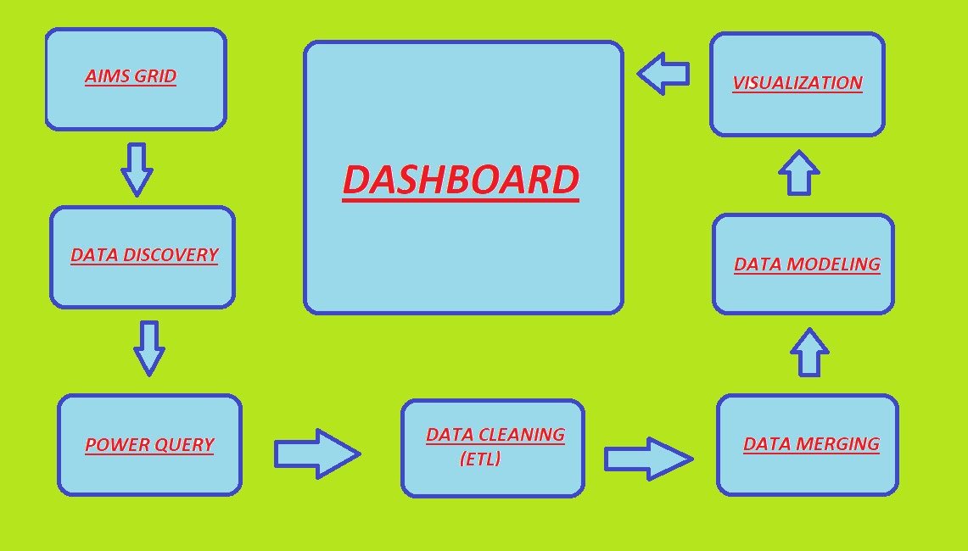
System Architecture/ Ideation Map
FIG 1 SYSTEM ARCHITECTURE
11 November 2021
Department of CSE
6

Slide 7
Project Implementation
We are going to implement AWESOME CHOCOLATES SALES ANALYTICS DASHBOARD (FMCG ANALYTICS)
The project planning is done using AIMS GRID
AIMS GRID is a project management tool , which has four components
Purpose
Stakeholder
End Result (FMCG SALES DASHBOARD)
Success Criteria
DATA DISCOVERY is done followed by aims grid
We use POWER QUERY tool , which is used to import and transform data

Slide 8
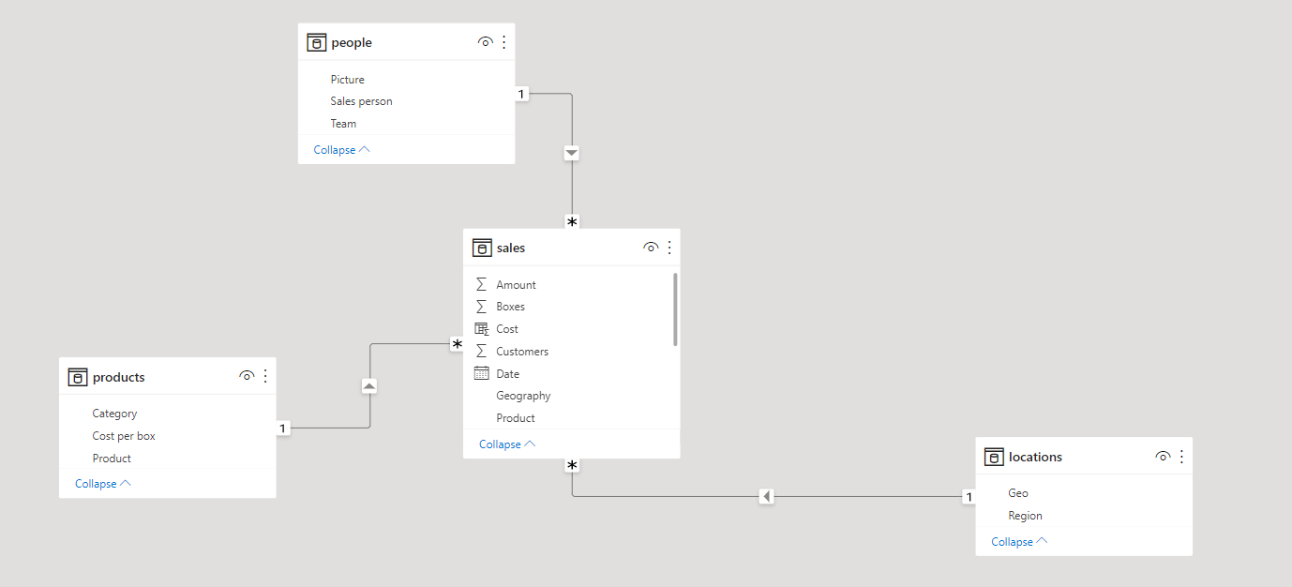
Project Implementation
DATA CLEANING and DATA MERGING is done (DATA WRANGLING or DATA MUNGING)
We need to connect the different tables by DATA MODELLING inorder to establish relationship between the tables , like a star schema model
FIG 2 STAR SCHEMA MODELLING

Slide 9
Project Implementation
VISUALIZATION and FORMATING is done in our POWER BI DASHBOARD followed by data modelling
We can integrate this dashboard in WEBPAGE or MOBILE APPLICATIONS

Slide 10
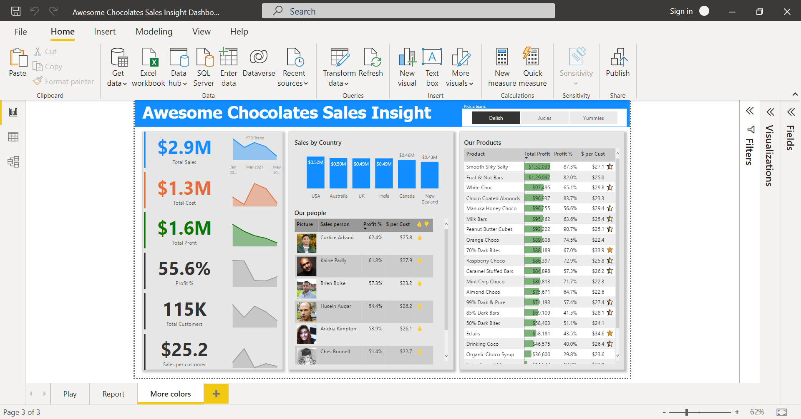
Sample Snapshot
FIG 3 SALES DASHBOARD

Slide 11
Results and Discussion
The main outcome of the project is to display the sales of various chocolate brands in a particular interval .
We have achieved the sales report of various chocolates , the raw inputs are obtained and stored in excel sheets, further it is converted into visual image .
In the system architecture we can clearly see that how the project works and how it was implemented .
In the problem implementation block the diagram represents the functionality of the project .
The sales insight dashboard is displayed in Power BI . Hence we have successfully obtained and displayed the sales insight of Awesome Chocolates

Slide 12
Conclusion
FMCG sales analytics dashboard is developed to enhance sales effectiveness of employees.
It helps salesperson and manager to easily analyse their sales and target effectiveness in a sophisticated manner.
It helps user to spend less time in analysing data and more time in gaining actionable insights.
FMCG sales dashboard not only ensure that you have high quality and real time data but also transforms it into meaningful recommendations for the present and future.
It shares sales metrics in real-time to allow you to take key sales-oriented business decisions at the right time, may it be from your boardroom or when you are on the move.

Slide 13
References
https://www.geeksforgeeks.org/power-bi-interactive-bi-dashboards
https://www.tutorialspoint.com/power_bi/index.htm
https://hevodata.com/learn/power-query-power-bi
https://powerquery.microsoft.com/en-us/power-bi
https://youtu.be/hhZ62IlTxYs

Slide 14
THANK YOU

